Slide 1
Springboard Training Project: Emerging Technologies
Team 4
Senthil Kumar
Dadi Swamy Vinay
Sourjya Pal

Slide 2
Route to modelling
Preparation
EDA
Outlier Treatment
Feature and Model Selection

Slide 3
PROBLEM
MARKET CAPITAL
98 BILLION $
CUSTOMERS
People
manufacturers
Vendor A, B, D, E, F, G, H, Private-Label, Others
Growth patterns of Themes and its positioning of Vendor_A

Slide 4
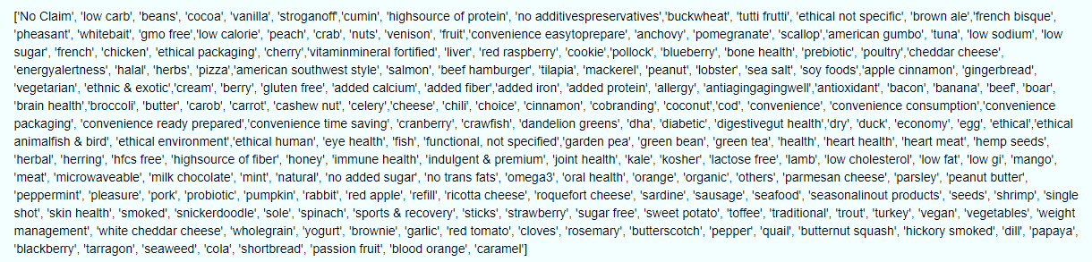
1.Data preparation
1.1 Unique Themes:

Slide 5
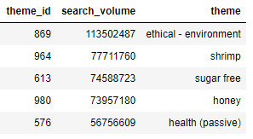
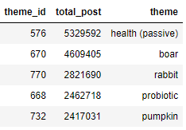
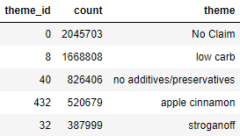
1.2 Popular themes across Datasets:
Search platforms
SOCIAL media
SALES

Slide 6
1.3 Data sufficiency, sparsity and anomaly
Social Media
Search Platforms
Product Manufacturer
Theme Product List
Theme List
Sales
1.4 Time Granularity
As the Sales Dataset is of Weekly update, Yearly Week-wise analysis is opted

Slide 7
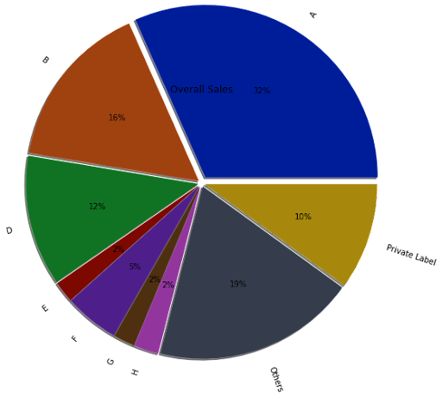
2. Data exploration
2.1 overall market share of our client
The market share of Vendor A is 32% which is 31.36bn $.

Slide 8
2.2 Potential competitors for our client in each theme:
Theme/Vendors | 1 | 2 | 3 | 4 | 5 | 6 | 7 | 8 | 9
No Claim | A | B | Private Label | D | Others | G | E | H | F
low carb | Others | F | A | D | Private Label | B | H
no additives/preservatives | F | Others | B | A | D | Private Label | H
Stroganoff | F | Others | D | A | B | H
Salmon | A | D | Private Label | Others | B | H | F
soy foods | A | B | H | D | F | Others | Private Label
apple cinnamon | Others | B | A | F | D | Private Label | H
Pollock | Others | B | A | D | Private Label | F | H
Cookie | B | A | D | Others | Private Label | H | F
Pizza | B | A | D | Others | Private Label | H | F
ethnic & exotic | Others | A | B | F | H | D | Private Label
american southwest style | Others | A | Private Label | F | D | B | H
Blueberry | Others | A | Private Label | F | D | B | H
Buckwheat | Others | D | A | B | Private Label | F | H
Herbs | Others | A | H | F
low sodium | Others | A | B | F | Private Label
high/source of protein | Others | A | B
Chicken | Others | A | Private Label | D | F | B | H
Crab | Others | F | A | Private Label
gmo free | F | Others | A | B | Private Label | H
Poultry | Others | A | B
french bisque | Others | D | B | A | F | Private Label
Tilapia | A | Others
Gingerbread | B | Others | H | F | A | D
brown ale | Others | A | Private Label | H | B
low sugar | Others | A | H | Private Label | B
american gumbo | F | Others | Private Label | A | H | B
ethical – packaging | B | Others | F | A
Beans | Others | D | A | Private Label
beef hamburger | Others | A
Vegetarian | Others | B | A | H
Tuna | A

Slide 9
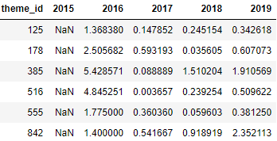
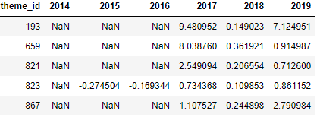

2.3 Emerging themes
Search Platforms
Anti-aging/Aging-well
Oral health
Salmon
Bone health
Social Media
Sea salt
Sales
Ethical - not specific
Halal
Based on Top Selling
Search Platforms
Nuts
Red Raspberry
Peanut
Microwaveable
Natural
Cranberry
Social Media
Poultry
Parsley
Bacon
Crawfish
Coconut
Sales
Poultry
Based on PCT change

Slide 10
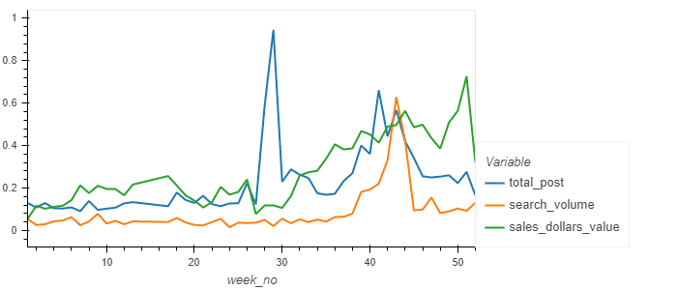
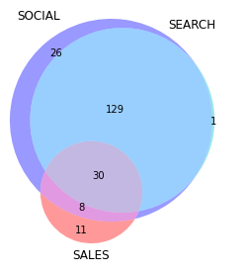
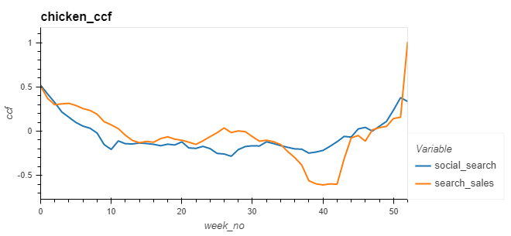
2.4 Trend flows from Social -> Search -> Sales
Theme:Chicken_2017
193 → 129 → 30

Slide 11
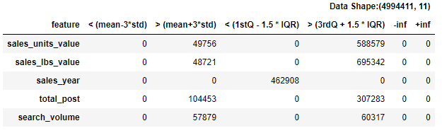
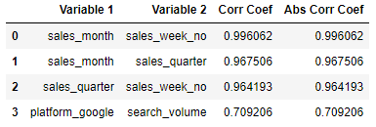
3.1 Model experimenting
Outlier Treatment
Percentile on Sales Units, Sales lbs , Search Volume and Total Post
Encoding
Target Encoding on Theme
One Hot Encoding on Vendors and Platforms
Correlation Effects
Sales_month, Sales_quarter, Platform_google are removed

Slide 12
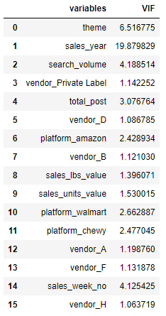
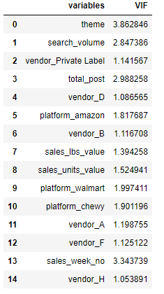
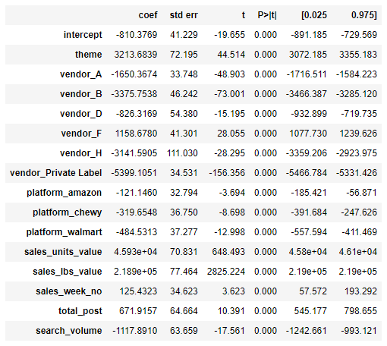
VIF Analysis (Linear Regression)

Slide 13
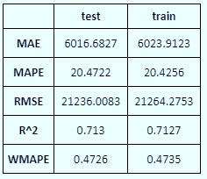
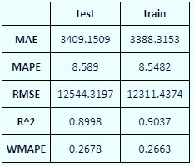
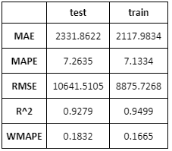
4. Model performance
ols model
Random forest
Xgboost
Linear Regression , XGBoost , RandomForest , Regression Comparison

Slide 14
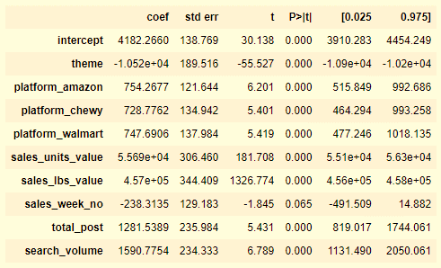
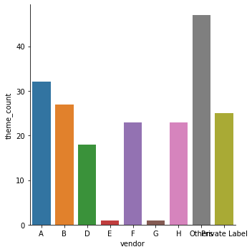
5. high business opportunity (901 Mn $)
Theme | Revenue | Vendors
Cumin | $73,89,84,415.00 | Others
ethical - not specific | $4,90,07,009.00 | Others
sea salt | $4,70,05,459.00 | Others
mackerel | $1,68,86,910.00 | Others
halal | $1,47,01,854.00 | Others
cherrry | $1,09,48,767.00 | Others
bone health | $81,08,027.00 | Others
peach | $54,17,871.00 | Others
red raspberry | $52,94,008.00 | B,Private Label
peanut | $17,31,056.00 | Others
energy/alertness | $13,92,018.00 | H,Private Label,Others
prebiotic | $5,98,513.00 | Others
convenience - easy-to-prepare | $5,67,388.00 | Others
nuts | $2,17,048.00 | Private Label,Others
scallop | $1,38,672.00 | Others
low calorie | $59,181.00 | Others
Vendor_A_Model

